Slide 1



Paper ID 01
Expert-Agnostic AI for Intelligent Tutoring Systems: Leveraging Self-Supervised Knowledge Mining
Paper Id : 727
Authors Names
S.V.N. Sreenivasu, Tippanaboina Ramesh, Shaik Mohammad Fayaz, Kinnera Yarra Jakraiah,
Dharmapuri Siri, Sesha Bhargavi Velagaleti
Name of the Department : CSE
Narasaraopeta Engineering College, Palnadu, Andhra Pradesh
2025 IEEE International Conference on Recent Advances in Computing and Systems, 19 -20 Dec 2025 | ABV-IIITM Gwalior India

Slide 2
Presentation
Outline
Introduction/ Background
Problem Statement, Dataset Description
Objectives
Methodology/ Architectures
Performance Measures
Results and Analysis
Conclusion and Future Scope
References
727
2025 IEEE International Conference on Recent Advances in Computing and Systems, 19 -20 Dec 2025 | ABV-IIITM Gwalior India

Slide 3
INTRODUCTION
Intelligent Tutoring Systems (ITS) aim to provide personalized learning by adapting content based on student behavior.
Traditional ITS rely heavily on domain experts for annotations and rule-based knowledge modeling.
Expert dependency limits scalability, flexibility, and real-time adaptability of tutoring systems.
Advances in deep learning enable models to learn directly from raw student interaction data.
Self-supervised learning removes the need for expert-labeled data by discovering patterns automatically.
Sequential student interactions can be effectively modeled using deep learning architectures such as RNNs, CNNs, and Transformers.
This research proposes an expert-agnostic ITS framework that predicts student performance using self-supervised learning on the EdNet-KT4 dataset.
727
2025 IEEE International Conference on Recent Advances in Computing and Systems, 19 -20 Dec 2025 | ABV-IIITM Gwalior India

Slide 4
Problem statement
Dataset Description
Existing Intelligent Tutoring Systems depend heavily on expert-defined rules and manually annotated data.
Creating expert-labeled datasets is time-consuming, costly, and difficult to scale across multiple domains.
Expert-driven systems limit flexibility and real-time adaptability to diverse learner behaviors.
Large-scale student interaction data remains underutilized due to reliance on handcrafted features and labels.
Many traditional models struggle to generalize across different subjects and learner populations.
There is a need for an intelligent tutoring framework that can learn directly from raw interaction data without expert intervention.
The challenge is to design an expert-agnostic, self-supervised system that accurately models student behavior and performance.
The study uses the EdNet-KT4 dataset, collected from the Santa online tutoring system.
It contains large-scale student interaction logs from approximately 300,000 learners.
Each student’s data is stored as an independent file, capturing detailed learning behavior.
The dataset includes temporal, behavioral, and performance-related features.
Key attributes include timestamp, action type, item ID, cursor time, source, user answer, and platform.
A filtered subset of interactions was selected to maintain representative data while ensuring manageable size.
The dataset provides rich sequential information suitable for self-supervised and deep learning-based student modeling.
727
2025 IEEE International Conference on Recent Advances in Computing and Systems, 19 -20 Dec 2025 | ABV-IIITM Gwalior India

Slide 5
OBJECTIVES
To design an expert-agnostic Intelligent Tutoring System that does not rely on domain experts or manual annotations.
To apply self-supervised learning for modeling student behavior using raw interaction data.
To evaluate and compare multiple deep learning architectures for sequential student interaction modeling.
To identify the most effective model for predicting student performance and engagement.
To demonstrate that high-accuracy student modeling can be achieved using unlabeled, large-scale educational data.
727
2025 IEEE International Conference on Recent Advances in Computing and Systems, 19 -20 Dec 2025 | ABV-IIITM Gwalior India

Slide 6
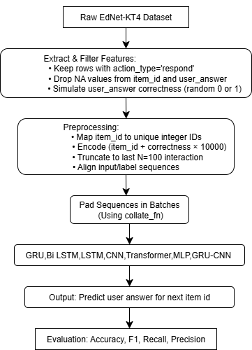
METHODOLOGY
Overall Pipeline :
Dataset Selection
Data Preprocessing
Feature Engineering
Sequence Preparation
Model Development
Training and Optimization
Performance Evaluation
Fig: Architecture Diagram
727
2025 IEEE International Conference on Recent Advances in Computing and Systems, 19 -20 Dec 2025 | ABV-IIITM Gwalior India

Slide 7
Dataset Selection
The EdNet-KT4 dataset containing over 300,000 student interaction records was used to model learning behavior and performance.
Data Preprocessing
Raw data was cleaned by removing incomplete sessions, handling missing values, and encoding categorical variables such as action type, item ID, and platform.
These steps ensured data consistency and improved model reliability during training.
Feature Engineering
Key behavioral and temporal features were extracted, including time differences between interactions, rolling averages, and sequence-based features to capture learning patterns.
Feature engineering enhanced the representation of student engagement and performance trends.
Sequence Preparation
Student interaction data was organized into fixed-length sequences of 100 interactions per user and transformed into 3D tensors suitable for deep learning models.
This sequence-based structure enabled effective modeling of temporal learning dependencies.
METHODOLOGY
727
2025 IEEE International Conference on Recent Advances in Computing and Systems, 19 -20 Dec 2025 | ABV-IIITM Gwalior India

Slide 8
Model Development
Seven deep learning models—MLP, LSTM, BiLSTM, GRU, CNN, Transformer, and a hybrid GRU-CNN—were implemented to predict student performance using self-supervised learning.
The models were selected to compare non-sequential, sequential, and hybrid learning approaches.
Training and Optimization
Models were trained using the Adam optimizer and Binary Cross-Entropy loss, with dropout and early stopping applied to prevent overfitting.
This training strategy ensured stable convergence and improved generalization.
Performance Evaluation
Model performance was evaluated using Accuracy, Precision, Recall, and F1-score, along with training and testing loss plots to analyze convergence and generalization.
These metrics enabled comprehensive comparison of model effectiveness and robustness.
METHODOLOGY
727
2025 IEEE International Conference on Recent Advances in Computing and Systems, 19 -20 Dec 2025 | ABV-IIITM Gwalior India

Slide 9
PERFORMANCE MEASURES
• The proposed expert-agnostic Intelligent Tutoring System is evaluated using standard classification metrics:
o Accuracy, Precision, Recall, and F1-Score
• Evaluation focuses on:
o Binary classification (Correct vs Incorrect responses)
o Performance comparison across deep learning models
• Model-wise analysis includes:
o MLP, LSTM, BiLSTM, GRU, CNN, Transformer, and Hybrid GRU-CNN
• Training and validation loss curves are analyzed to assess:
o Model convergence and generalization
o Overfitting and underfitting behavior
• The evaluation setup uses:
o Train–test split
o Self-supervised learning on sequential interaction data
727
2025 IEEE International Conference on Recent Advances in Computing and Systems, 19 -20 Dec 2025 | ABV-IIITM Gwalior India

Slide 10
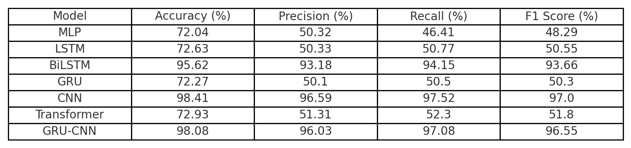
RESULTS AND ANALYSIS
Seven deep learning models were evaluated on the EdNet-KT4 dataset under a self-supervised learning framework.
The CNN model achieved the highest accuracy of 98.41%, demonstrating strong capability in capturing local interaction patterns.
The hybrid GRU-CNN model achieved 98.08% accuracy, showing robust performance by combining short-term pattern extraction and long-term dependency modeling.
Sequential models such as BiLSTM (95.62%) also performed well, benefiting from bidirectional context in student interaction sequences.
LSTM and GRU showed stable but comparatively lower performance, indicating limitations in modeling complex learning behaviors alone.
MLP and Transformer models achieved lower accuracy (~72%), as MLP lacks temporal awareness and the Transformer showed overfitting on limited sequence lengths.
Training and validation loss curves reveal that CNN and GRU-CNN exhibit smooth convergence and minimal overfitting, indicating good generalization.
Overall, results confirm that high-accuracy student performance prediction is achievable without expert-labeled data using self-supervised deep learning models.
Table: Evaluation Metrics Results Of Each Model
727
2025 IEEE International Conference on Recent Advances in Computing and Systems, 19 -20 Dec 2025 | ABV-IIITM Gwalior India

Slide 11
CONCLUSION & FUTURE SCOPE
Conclusion
The proposed self-supervised, expert-agnostic ITS predicts student performance effectively without expert-labeled data.
CNN and GRU-CNN achieved the best results, proving strong generalization from raw interactions.
The system offers a scalable and adaptive framework for personalized, domain-independent learning.
Future Scope
Integrate multimodal data like facial, voice, and text cues for better engagement detection.
Use reinforcement learning for adaptive and personalized feedback.
Test the system in low-resource educational environments.
Apply interpretability and fairness methods for ethical AI deployment.
727
2025 IEEE International Conference on Recent Advances in Computing and Systems, 19 -20 Dec 2025 | ABV-IIITM Gwalior India

Slide 12
REFERENCES
K. Cho et al., ”Learning phrase representations using RNN encoder-decoder for statistical machine transla- tion,” in Proc. EMNLP, pp. 1724–1734, 2014.
S. Hochreiter and J. Schmidhuber, ”Long short-term memory,” Neural Computation, vol. 9, no. 8, pp. 1735 1780, 1997.
A. Graves and J. Schmidhuber, ”Framewise phoneme classification with bidirectional LSTM networks,” in Proc. 2005 IEEE Int. Joint Conf. Neural Networks, vol. 4, pp. 2047–2052.
D. E. Rumelhart, G. E. Hinton, and R. J. Williams, ”Learning internal representations by error propagation,” in Parallel Distributed Processing, vol. 1, MIT Press, 1986.
Y. LeCun et al., ”Gradient-based learning applied to document recognition,” Proc. IEEE, vol. 86, no. 11, pp. 2278–2324, 1988.
A. Vaswani et al., ”Attention is all you need,” Adv. Neural Inf. Process. Syst., vol. 30, 2017.
W. Yin et al., ”Comparative study of CNN and RNN for natural language processing,” arXiv preprint arXiv:1702.01923, 2017.
Y. Kim, H. Lee, and G. Lee, ”EdNet: A large-scale hierarchical dataset in education,” in Proc. AIED, 2020.
A. Raffel et al., ”Exploring the limits of transfer learning with a unified text-to-text transformer,” J. Mach. Learn. Res., vol. 21, no. 140, pp. 1–67, 2020.
X. Chen et al., ”Intelligent tutoring systems in higher education: A review,” Computers & Education, vol. 144, p. 103700, 2020.
B. D. Nye, ”Intelligent tutoring systems by the numbers: A review of 50+ years of research,” in Artificial Intelli- gence in Education, Springer, 2015, pp. 1–12.
H. Wang, Y. Zhang, and X. Ma, ”Deep learning for behaviour recognition in classroom surveillance videos,” IEEE Trans. Learning Technologies, vol. 15, no. 1, pp. 24–36, 2022.
727
2025 IEEE International Conference on Recent Advances in Computing and Systems, 19 -20 Dec 2025 | ABV-IIITM Gwalior India

